Slide 1
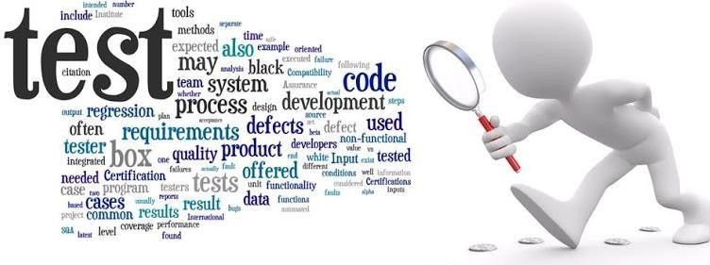
How do we start Testing?

Slide 2
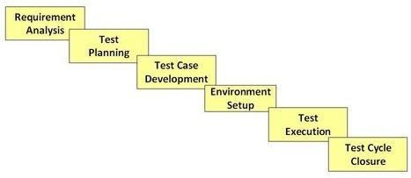
Software Testing Life Cycle
STLC is a process of sequence activities conducted to perform Software Testing.
In STLC process, different activities are carried out to improve the quality of the product.

Slide 3
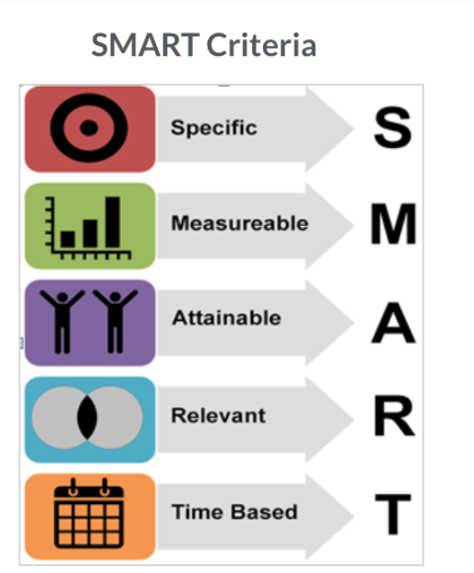
Requirement Analysis
Test team studies the requirements from a testing point of view to identify the testable requirements.
We test requirements against SMART criteria

Slide 4
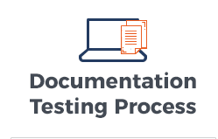
Test Documentation
Proper documentation makes testing more accurate in an organization and easy for the client to review the software process.
A project’s documentation makes testing process easy and organized.
Proper documentation saves company money and time spent on that project. Not all documents are important.

Slide 5
Test Planning
Test plan is the project level document that is usually created by QA Manager or Test Lead (based on the company) and mostly used in waterfall projects.
Test plan outlines the strategy that will be used to test an application.
The resources that will be used.
The test environment in which testing will be performed, the limitations of the testing and the schedule of testing activities.

Slide 6
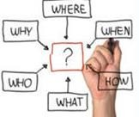
Test Plan
Test Plan answers to following questions:
What to test?
How to test?
Why to test?
Who will perform the testing?
Where testing will be performed?
When testing will take place?

Slide 7
Test Plan Content
Introduction to the Test Plan document.
Add the purpose of the document you are creating.
Test Plan overview
Provide few liner overview of your test plan
Assumptions while testing the application.
Design and coding is done, Unit testing is performed, test team have access to test env.
List of features to be tested, such as bellow:
Search feature, result feature, about feature
Environmental Needs
Dev environment, Test Environment, ACPT...
What sort of approach to use while testing
Do you focus on Functional tests, regression, progression testing.
The resources allocated for testing the application
List the names of resources and their rules & responsibilities
The testing tools will be used.
List the tools that will be used. Such as: JIRA, ALM, QC etc

Slide 8
Test Case Development
This phase involves creation, verification and rework of test cases & test scripts.
A test case is a document which has a set of actions/steps that needs to be executed to verify a feature or functionality of your software application.
Why do we need a test case?
Test cases makes the whole QA process more efficient. It can also show new colleagues how the app or site is supposed to work

Slide 9
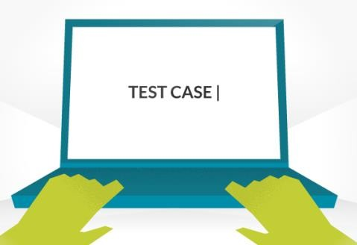
Test Cases
A test case often contains:
Test Case ID Or Test Case Name
Pre-condition
Steps Number
Steps Detail / Description
Expected Result
Actual Result
Comments
Pass Y/N

Slide 10
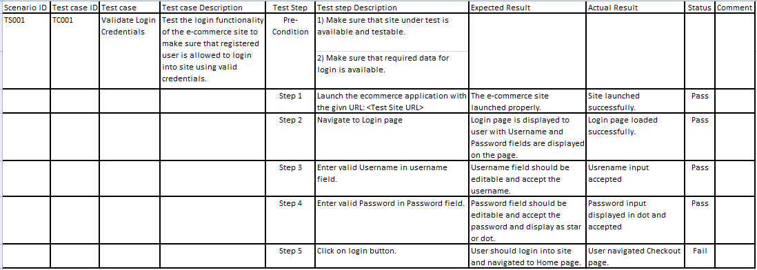
Test Case Example

Slide 11
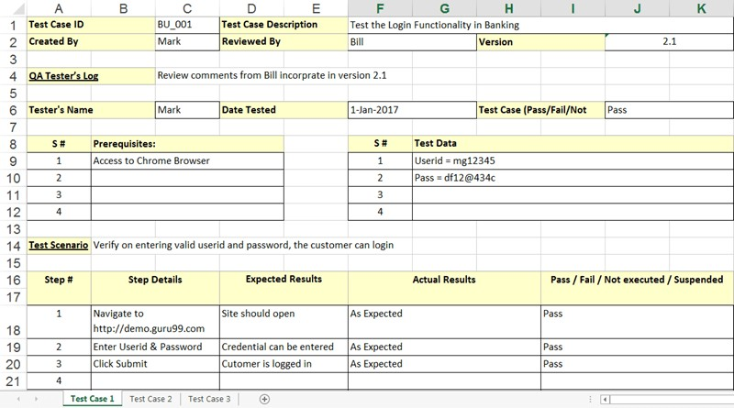
Test Case Example

Slide 12
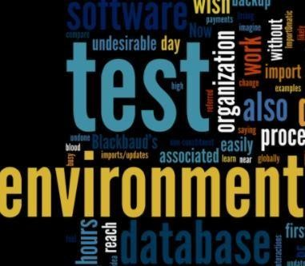
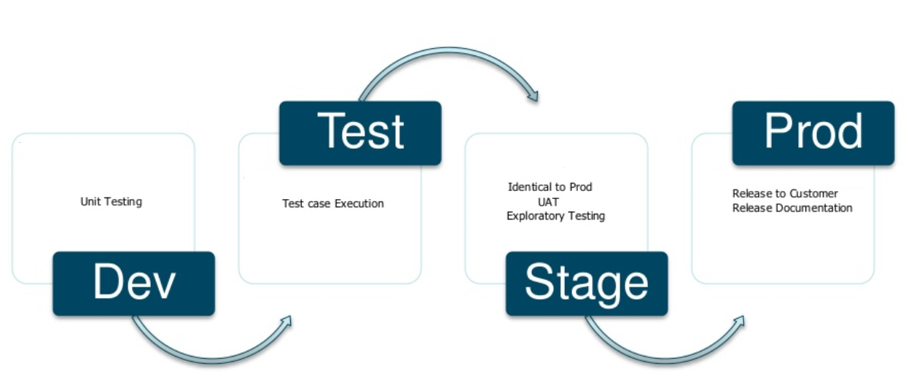
Test Environment Set Up
Testing Team is not involved in setting up the environment; however, team should prepare the smoke test cases to check the readiness of the test-environment setup.
DEV Environment - where developers make code
TEST Environment - where testers do test
PROD Environment - live application that is available for all real users/end user/customers where we usually don’t have access as testers or only have read-only access.

Slide 13
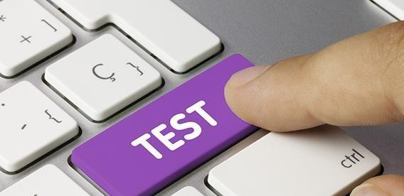
Test Execution
Testing team start executing test cases that was developed.
Bugs will be reported back to the development team for correction and retesting will be performed.

Slide 14
Test Cycle Closure
Testing team will meet , discuss and analyze testing artifacts to identify strategies that have to be implemented in future, taking lessons from the current test cycle.

Slide 15

Manual Testing
Class 2

Slide 16
Agenda
Test Case Development
JIRA

Slide 17
Create a Test Case
US 78953 - As a user I should be able to log into a Netflix account with valid credentials.
Note: user should click sign in button located in upper right hand corner of page

Slide 18
Task
Create a Test Case
User Story 1657 - AC: As an admin I should be able to login into Syntax HRMS with valid credentials
Environment: HRMS Test Environment:
http://hrm.syntaxtechs.net/humanresources/symfony/web/index.php/auth/login
Admin Credentials:
Username: TBD
Password: TBD

Slide 19
Manual Testing
Class 3

Slide 20
Agenda
What is a Bug
Bug Life Cycle

Slide 21

What is a Bug?
Wikipedia Definition - A software bug is an error, flaw, failure or fault in a computer program or system that causes it to produce an incorrect or unexpected result, or to behave in unintended ways

Slide 22
What is a Bug?
It is an unexpected result you find during testing when you are comparing expected result with actual result.
Bug can also be a tester finding software difficult to understand, hard to use, or slow from an end-user point of view.
A software bug is an error, flaw, failure or fault in a computer program or system that causes it to produce an incorrect or unexpected result, or to behave in unintended ways.

Slide 23
Bug Examples
Software Doesn’t do something that specification says it should do.
Example - User was not able to login with valid credentials.
Software does something that specification says it should NOT do.
Example - User was able to login with invalid credentials.

Slide 24
Bug Examples
Software Does something that specification does not mention.
Example - Software allowed user to add 2 spouses to the policy.
Software Doesn’t do something that specification doesn’t mention but it should.
Example - Login button is in-between Username and Password field.
https://www.youtube.com/watch?v=UlhGhj1tj-A

Slide 25
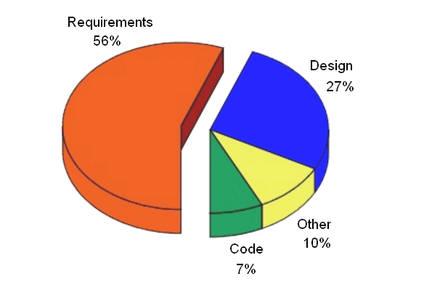
Why Bugs Occur?
It has been shown that some 56% of all software defects emerge during the requirement phase, 27% in the design phase, and only 7% during the development phase.

Slide 26
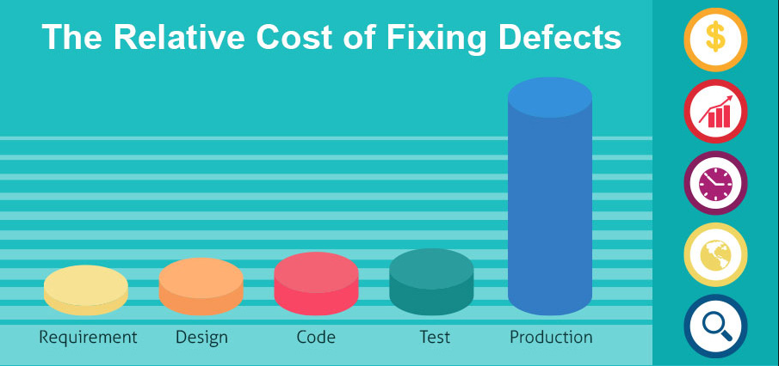
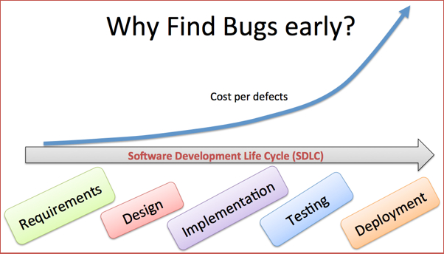
Why Bugs Occur?

Slide 27
What should we do after a bug is found?
In Software testing, when the expected and actual behavior is not matching, an incident needs to be raised/reported.
Before reporting a bug:
ALWAYS:Try to reproduce the BUG
Check requirements (requirements update or functionality removed)
Once bug is reproducible you need to report it
How Reporting Works? What should be included in Reporting? Time

Slide 28
Priority and Severity of the Bug
Severity is defined as the level of impact that bug has on the functionality of application/system.
Severity indicates the seriousness of the defect on the product functionality
Priority is defined as the order in which a defect should be fixed. Higher the priority the sooner the defect should be resolved.
Priority indicates how soon the bug should be fixed

Slide 29
Priority categorization
Show Stopper: Not able to test application further.
Major: Major functionality not working but able to test application.
Minor: The defect that does not result in the termination and does not damage the usability of the system
Cosmetic: Issues in location of the object or the look and feel issue.

Slide 30
Severity categorization
Low: The defect is an irritant but repair can be done once the more serious bugs have been fixed
Medium: During the normal course of the development activities defect should be resolved. It can wait until a new version is created
High: The defect must be resolved as soon as possible as it affects the system severely and cannot be used until it is fixed

Slide 31
Examples:
High Priority & High Severity: User is unable to login to their Bank of America account
High Priority & Low Severity: Bank of America logo on the front page misspelled as ‘Bank of Amerika’
High Severity & Low Priority: On Syntax Technologies website under ‘Campus’ section not able to scroll to view pictures
Low Priority and Low Severity: Any cosmetic issues (Image is displaying on top right instead of center right) or spelling issues (when user trying to make purchase there is always acknowledge message)

Slide 32
Bug Life Cycle
Bug life cycle is the specific set of states that a Bug goes through from discovery to defect fixation. It varies from organization to organization, from project to project and also depends upon the tools used.
Bug Life Cycle:
New: When a new defect is logged and posted for
the first time. It is assigned a status NEW.
Rejected: If the developer feels that the bug is not genuine, developer rejects the bug. Then the state of the bug is changed to “rejected”.
Assigned: Once the bug is posted by the tester, the lead of the tester approves the bug and assigns the bug to developer team.

Slide 33
Bug Life Cycle
Open: The developer starts analyzing and works on the defect fix
Fixed: When developer makes necessary code change and verifies the change, he/she can make bug status as "Fixed."
Retest: Tester do the retesting to check whether bug got fixed or not.
Reopened: If the bug still exists even after the bug is fixed , the tester changes the status to “reopened”. The bug goes through the life cycle once again.
Closed: Once the bug is fixed, it is tested by the tester. If the tester feels that the bug no longer exists in the software, tester changes the status of the bug to “closed”. This state means that the bug is fixed, tested and approved.

Slide 34
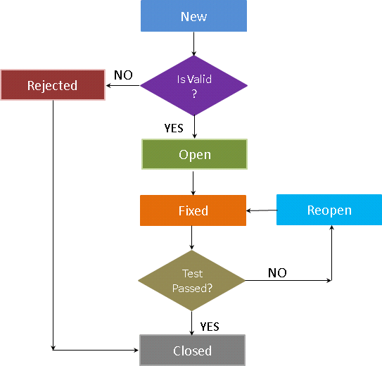
Bug Life Cycle

Slide 35
Manual Testing
Class 4

Slide 36
Agenda
Functional vs Non Functional Testing
Software Testing Hierarchy
Different Types of Testing:
Regression Test
Ad hoc Test
Smoke Test
508 Compliance
Whitebox vs Blackbox Testing techniques

Slide 37
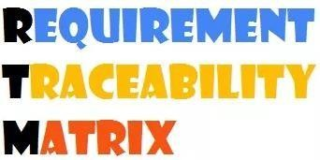
What is RTM?
It is a document that maps and traces user requirement with test cases.
The main purpose of RTMis to see that all requirements are covered so that no functionality should be missed while testing. RTM is the mapping between requirement to test cases and test cases to the defect. If there is defect found we can trace back to tell which specific requirement failed.
It is also called requirement coverage, one on one mapping.

Slide 38
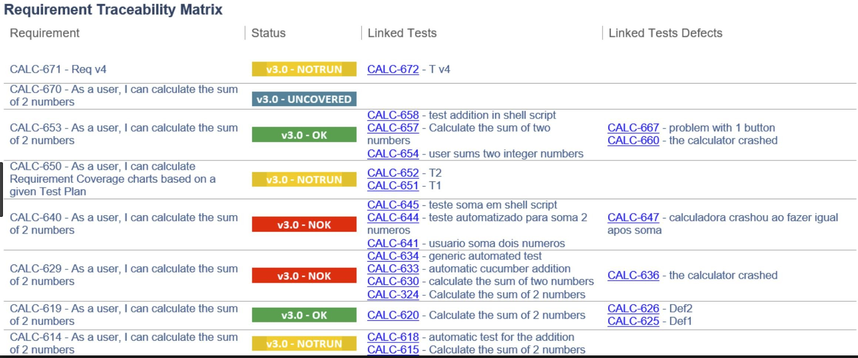
RTM Example

Slide 39
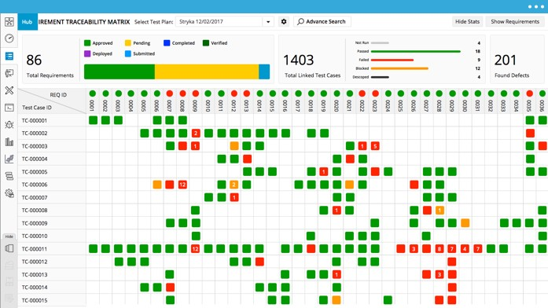
RTM Example

Slide 40
Two Types of Testing
Functional Testing
Non-functional Testing

Slide 41
Functional Testing
Is a type of testing when we test the functionality of the application.
First thing we do when a code or new functionality comes from developers so make sure that the functionality is working fine according to business requirements, and doesn’t have any major bugs.
Functional testing is performed by manual testers and by automation team.
Examples: Can user login? Can user logout?
Functional testing is designed to determine that the application’s features and operations perform the way they should.

Slide 42
Non- Functional Testing
Testing software application or system for its non-functional requirements: The way a system operates, rather than specific behaviors of that system.
Non-functional testing is designed to figure out if your product will provide a good user experience.
For example, non-functional tests are used to determine how fast the product responds to a request or how long it takes to do an action (performance testing)
Non-functional testing wants to see if the product stands up to customer expectations.
Look and Feel are also part of non-functional testing

Slide 43
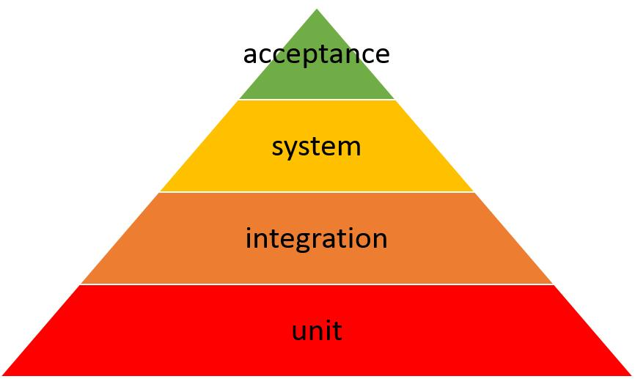
Software Testing Hierarchy

Slide 44
Unit Testing
Unit is smallest testable part of an application like functions, classes etc.
It’s part of the white box testing.
It’s done by developers. They execute and evaluate their code and if they find any bugs they fix it before it come to QA environment and testers finds it.
As a tester we do not perform unit testing
Developer – DEV Environment

Slide 45
Integration Testing
Validate the interaction of related components, modules and systems to ensure they work together.
Test individual software components to verify interaction between various software components and detect interface defects. After the integration testing has been performed on the components, they are readily available for system testing.
For Ex. Amazon video will work fine as a standalone component. But when you put Amazon video code together with the rest of the website it is no longer working. We need to make sure that all the components when integrated together are able to interact with each other and work properly.

Slide 46
System Testing
System testing is testing complete and fully integrated software product. Everything together like integrated component, Front end, back end, database, server etc.
Test that the behavior and functionality of the complete and fully integrated application complies with specified requirements.
Also called End to End scenario testing.
It also tests overall user experience.
QA Manual/Automation- TEST/SIT Environment

Slide 47
Acceptance Testing
Once the application has completed it is delivered to user or customer and tested by them for acceptance testing.
Acceptance testing is basically done by the user or customer although other stakeholders may be involved as well. Work with subject matter experts and business stakeholders to guide them through the user acceptance testing process, ensuring that the application meets business needs
Also known as UAT User Acceptance Testing.
Companies can also have UAT Team to perform User Acceptance Testing. Once QA team and Dev team completes the testing then UAT team tests the product. UAT team assures that the product works fine, as expected before it goes to business.
USERS - STAGE/UAT Environment

Slide 48
Different testing types
There are different testing types that we as testers can perform
Smoke
Regression
Performance
Ad Hoc

Slide 49
Smoke Test
A smoke test is a quick, lightweight test or set of tests, usually automated, that confirm that the basic functionality of system is working correctly. It tends to emphasize broad, not deep tests, and is usually done before launching a more extensive set of tests.
Smoke test quickly scans the application through multiple high level scenarios under 30 mins to make sure that the application is working fine (Environment is UP or Down).
If something does not work, it sends out an email to everyone, letting them know that smoke test did not pass. This is mostly done through automated script.
Automated Smoke test can be scheduled multiple times a day to give timely report to the team.

Slide 50
Regression Testing
Regression testing is a software testing practice that ensures an application still functions as expected after any code changes, updates, or improvements.
Regression testing is responsible for the overall stability and functionality of the existing features. Whenever a new modification is added to the code, regression testing is applied to guarantee that after each update, the system stays sustainable under continuous improvements.
Regression testing is performed before every application release.
Regression test cases are perfect for test automation because it is repetitive and very time consuming.

Slide 51
Regression Testing
When to apply regression testing:
A new requirement is added to an existing feature
A new feature or functionality is added
A modifications/changes been applied to the existing feature
The codebase is fixed to solve defects
The source code is optimized to improve performance

Slide 52
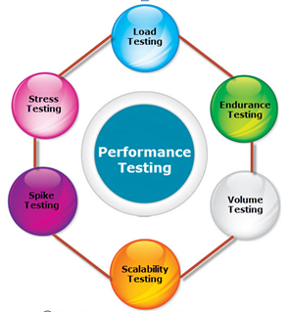
Performance Testing
Performance testing, a non-functional testing technique performed to determine the system parameters in terms of responsiveness and stability under various workload.
It measures the quality attributes of the system, such as scalability, reliability and resource usage etc.
Example: Can 2000 user login to the application at the same time? Can user move to the next page in 1 second?

Slide 53
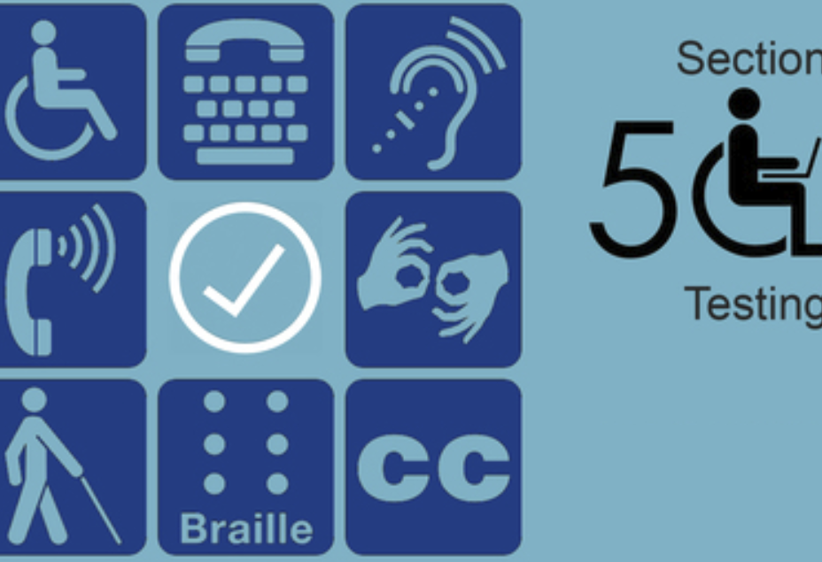
508 Compliance Testing
Section 508 is a requirement for all websites, and in general, for all federal departments and agencies to ensure that their electronic information & technology (EIT) is accessible to people with disabilities.
508 Compliance testing is to make sure disable people can use it as well.
Mandatory for government websites.
Popular tool used for 508 testing is JAWS(Job Access With Speech)

Slide 54
Ad-Hoc Testing
Testing performed without planning and documentation.
Informal testing OR least formal test method.
A lot of Bugs can be find in ad-hoc testing.
Performed mostly after official testing is done and still sometime is left for testing the application.
It can be also called Exploratory testing, Random Testing

Slide 55
Retesting
Regression testing is done to find out the issues which may get introduced because of any change or modification in the application. The purpose of regression testing is that any new change in the application should NOT introduce any new bug in existing functionality.
Verification of bugs are During retesting only failed test cases are re-executed. Retesting is carried out to ensure that the original issue is working as expected. Retesting is executed in the same environment with same data but in new build.

Slide 56
Different testing techniques
There are different testing techniques could be used such as:
White box testing
Black box testing
Positive testing
Negative Testing
Boundary Value analysis

Slide 57
White-box testing techniques
Requires detailed programming skills.
Mostly done by developers where they execute their code before it goes to QA. environment like unit testing
Internal structure is known to the Developer who is going to test the software.

Slide 58
Black-box testing
techniques
Requires no knowledge of internal paths, structures, or implementation of the software being tested.
Tester doesn’t know what is inside.
All the tester knows is what the software is supposed to do and if the software is doing its job correctly
Black-box testing only cares about input / output

Slide 59
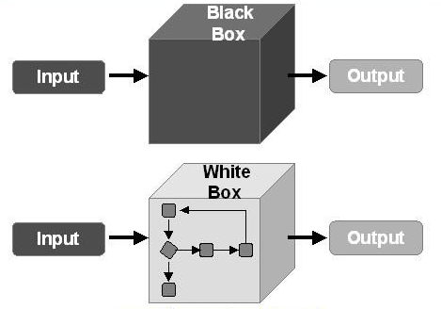
White-box
v.s
Black-box

Slide 60
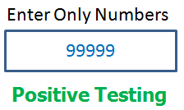
Positive Testing
Testing the application with valid input.
Example: If you are doing positive testing for buying functionality, you would use only valid credit card number and expiration date.

Slide 61
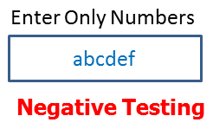
Negative Testing
Test the application with invalid data as input.
Checks whether application behaves as expected with invalid / negative input.
Test the application to see that it does not do anything that it is not supposed to do.
Example: Login with invalid username and password. You go to ATM today and try to take 1000 dollars out or you can put in Costco card and see what happens. Give your own …

Slide 62
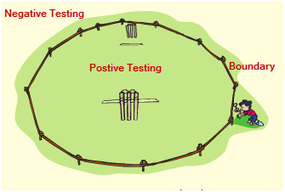
Boundary Value Analysis
Boundary testing is to make sure the software accepts valid data inside the valid Boundary (Lower
Boundary and Higher Boundary) and rejects invalid data outside the valid Boundary.
Example: Tax return period is from January 1st until April 15th. If you spend less than $50 and amazon.com still did not charge you for shipping, it means there is a defect in the application. Many defects can be found with this method.

